Slide 1
OIC Course 2024
Contents:
Oracle Integration Cloud
Oracle Fusion Technical
Hands on Live Integration practice

Slide 2
OIC Overview
Oracle Integration Cloud provides a fully managed, preconfigured environment that gives you the power to integrate your cloud and on-premises applications. Selecting from the portfolio of hundreds of adapters and recipes to connect with Oracle and third-party applications, developers and cloud architects can connect SaaS and on-premises applications six times faster with a visual development experience, prebuilt integrations, and embedded best practices.
OIC acts as medium/bridge between multiple Applications. Ex: Bridge between FTP and Oracle SaaS Application.

Slide 3

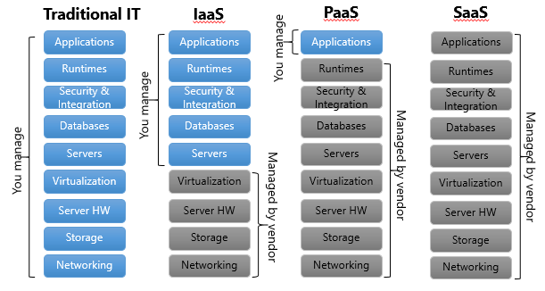
IaaS, PaaS and SaaS
SaaS - Oracle Application HCM or ERP
PaaS - OIC, VBCS, ATP and PCS
IaaS - OCI

Slide 4
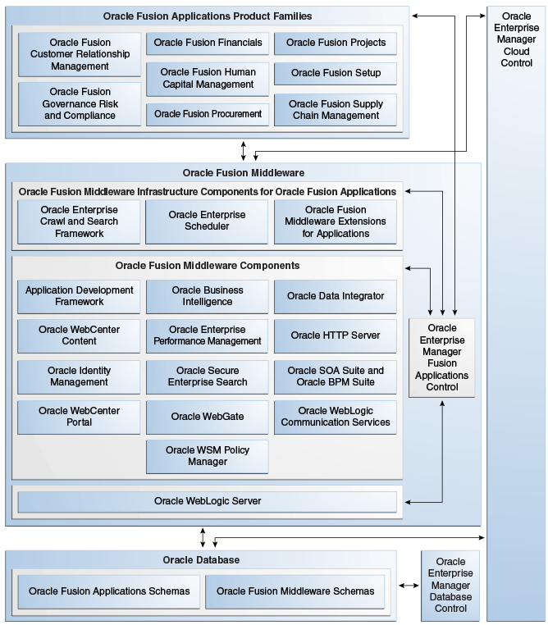
Oracle Fusion Architecture

Slide 5
SOAP Webservers and WSDL
SOAP (Simple Object Access Protocol) is a widely used protocol for exchanging structured information in the implementation of web services. In OIC 3, exposing SOAP services allows organizations to leverage existing systems and data by making them accessible to other applications and services in a standardized manner.
WSDL is an XML format that describes distributed services on the Internet.
Example: Access BIP report from OIC and WSDL URL is https://servername/xmlpserver/services/ExternalReportWSSService?WSDL

Slide 6
REST Webservices/API
A REST API (also known as RESTful API) is an application programming interface (API or web API) that conforms to the constraints of REST architectural style and allows for interaction with RESTful web services.
REST API is used to get/update/load data from/into Oracle Application/Third Party Application in OIC.
Supported formats: JSON, XML or Binary.
REST adapter/connection is used in OIC to access Oracle Cloud REST API or Third Party API.

Slide 7
OIC Adapters/Connections
FTP Connection
SOAP Adapter
REST Adapter
Oracle HCM Cloud Adapter
Oracle ERP Cloud Adapter
Oracle ATP Adapter
Oracle ADW Adapter
Above all Adapters/Connections are available in OIC and it should be configured to access these applications.
Configuring Above connections are shown in Hands-On Lab Document.

Slide 8
Integration Patterns
Schedule Based Integration: This pattern is used for schedule basis Integration and these types of Integrations can be scheduled with time. Example: Integration to run at 5 AM EST Every day.
Application/App Driven Integration: This pattern is used to expose it as REST Event or Event Based Integration. This can be triggered by using Integration metadata link.
Event: This pattern is used to trigger Integration when some events are published.

Slide 9
OIC Lookups
OIC Lookups are used to store data against key column which can be used in Integration to retrieve data from Lookup.
Advantages:
1. If Lookup is maintained, no need to touch Integration for any changes for important data because we can directly make changes in lookup.
2. Each Integration can have each row in lookup to maintain it is own details. (Ex: Using FRICE ID as key column and enter other details against this column)
Configuring OIC Lookups are shown in Hands-On Lab Document.

Slide 10
OIC Integration Implementation
Creating Integrations, Data Mapping, Configuring Adapters and Configuring OIC Lookups are shown with step by step in Hands-On Lab Document.
Hands-On Implementation:
1. Inbound Integration to ERP – GL FBDI
2. Inbound Integration to HCM - Worker HDL
3. Fusion Reporting – BIP and OTBI
4. ESS Job
5. UCM
6. Report Integration
7. Supplier Outbound Integration - REST API and FTP

Slide 11
ALL THE BEST!!

